Slide 1



A Study of Applications of Physics-Informed Neural Networks
Haley Rathman¹, Antonio Falbo¹, Madhav Raghavendra², Marjorie Romero², Agustin Menjivar¹, Ava Oberrender¹, and Alexey Prokudin^{1,3}
1 – The Pennsylvania State University – Berks Campus
2 – The Pennsylvania State University
^{3- Jefferson Lab}

Slide 2
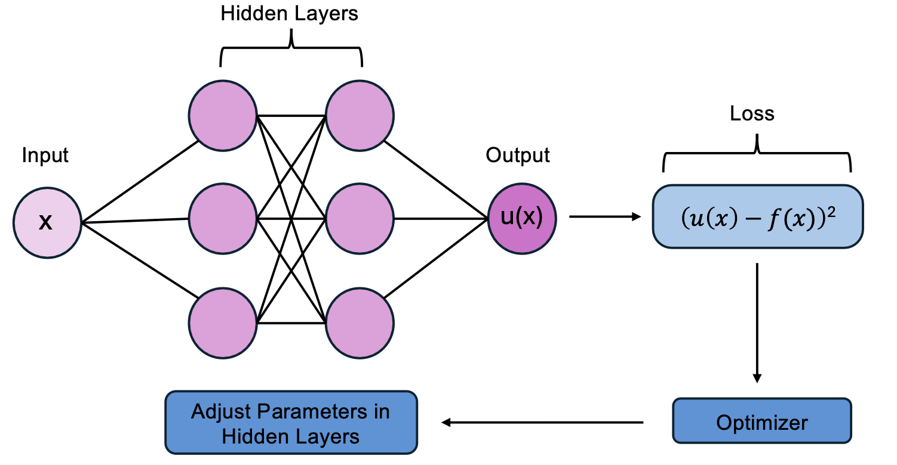
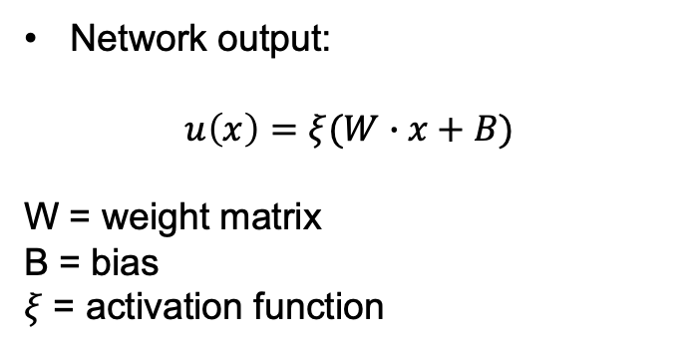
Neural Networks
Universal function approximators
Network output:
$$u\left(x\right)=ξ(W∙x+B)$$
W = weight matrix
B = bias
$ξ$ = activation function
Flexibility - both a strength and weakness
General Schematic of a Neural Network
Notes:
Walk through figure to explain basics of N.N., mention activation functions (used to induce nonlinearity in your solutions) and automatic differentiation (in relation to adjusting params of hidden layers).

Slide 3
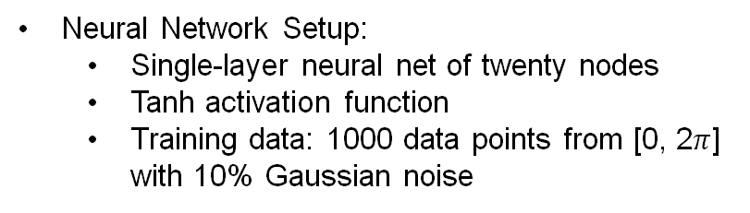
Neural Networks: Sine Modeling
Time Series Modeling:
Weather prediction (Han et al., 2021)
Stock market
Neural Network Setup:
Single-layer neural net of twenty nodes
Tanh activation function
Training data: 1000 data points from [0, 2$π$] with 10% Gaussian noise
Neural Network modeling sin(x) with training data.
Notes:
Why model the sine function? Inherent periodicity appears in time series modeling that can be used to model the weather or the stock market.
Jung Min Han, Yu Qian Ang, Ali Malkawi, Holly W. Samuelson, Using recurrent neural networks for localized weather prediction with combined use of public airport data and on-site measurements,
Building and Environment, Volume 192, 2021, 107601, ISSN 0360-1323, https://doi.org/10.1016/j.buildenv.2021.107601.

Slide 4
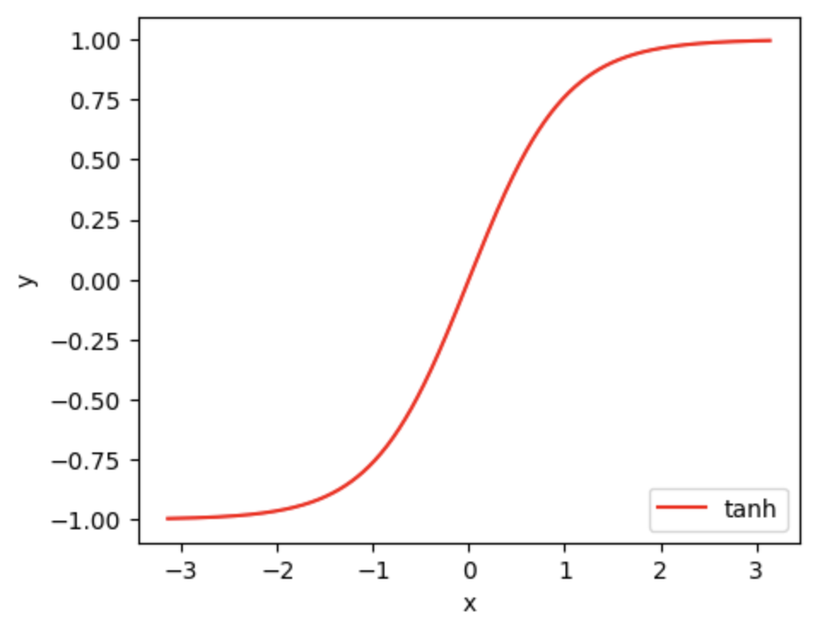
Neural Networks: Sine Modeling
Excellent prediction in the training domain, quickly worsens outside of the training domain
Recall the behavior of tanh:
Neural Network prediction of sin(x).

Slide 5
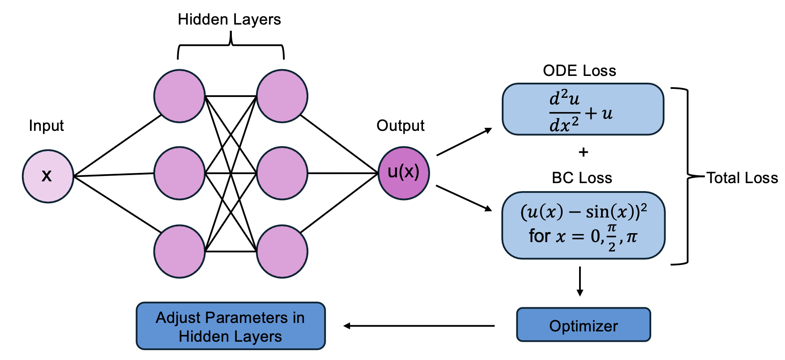
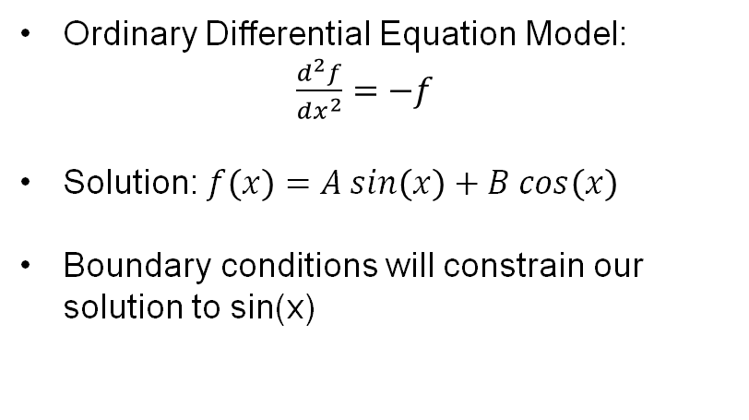
Physics-Informed Neural Networks
Physics-Informed Neural Networks (PINNs):
Developed by Raissi, Perdikaris, and Karniadakis (2019).
Physics-informed loss defines the loss relative to a differential equation
Ordinary Differential Equation Model:
$\frac{d^{2}f}{dx^{2}}=−f$
Solution: $f\left(x\right)=A sin\left(x\right)+B cos\left(x\right)$
Boundary conditions will constrain our solution to sin(x)
Schematic of a Physics-Informed Neural Network (PINN).
Notes:
Raissi, M., Perdikaris, P., & Karniadakis, G. E. (2019). Physics-informed neural networks: A deep learning framework for solving forward and inverse problems involving nonlinear partial differential equations. Journal of Computational Physics, 378, 686–707. https://doi.org/10.1016/j.jcp.2018.10.045

Slide 6
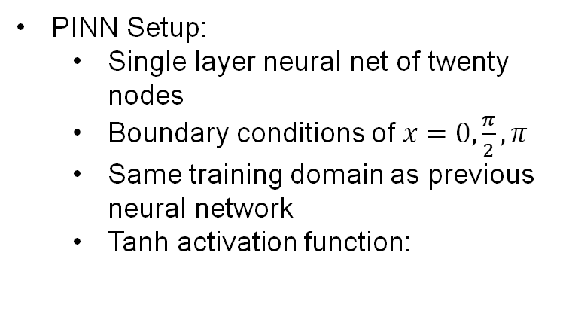
Initial PINN Models
PINN Setup:
Single layer neural net of twenty nodes
Boundary conditions of $x=0, \frac{π}{2}, π$
Same training domain as previous neural network
Tanh activation function:
Initial PINN prediction of sin(x).
Notes:
Talk about initial model problems – No periodicity in output,
Describe how this was with tanh function

Slide 7
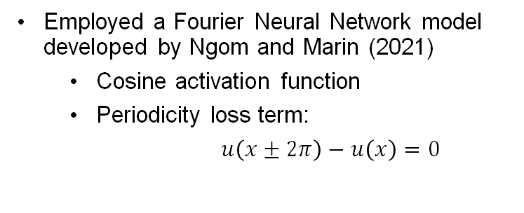
PINN Solution
Employed a Fourier Neural Network model developed by Ngom and Marin (2021)
Cosine activation function
Periodicity loss term:
$u\left(x±2π\right)−u\left(x\right)=0$
Same architecture, training data, and boundary conditions as previous PINN
Key takeaways:
The choice of activation function can greatly affect the PINN’s predictions
The behavior of the activation function should reflect the behavior of the differential equation (Wang et al., 2023)
Physics-informed Fourier neural network prediction of sin(x).
Notes:
Ngom, M., & Marin, O. (2021). Fourier neural networks as function approximators and differential equation solvers. Statistical Analysis and Data Mining: The ASA Data Science Journal, 14(6), 647-661. https://doi.org/10.1002/sam.11531
Wang, H., Lu, L., Song, S., & Huang, G. (2023). Learning specialized activation functions for physics-informed neural networks. Communications in Computational Physics, 34(4), 1125–1151. https://doi.org/10.4208/cicp.OA-2023-0058

Slide 8

Future Directions
Next, we plan to use a PINN to model Maxwell’s equations
In addition, we plan to use PINNs to model the integro-differential equations that describe the internal structure of the nucleon
QR code to our Google Colab notebook that contains all the PINNs/graphs in this presentation

